Slide 1
Caritas Europa

Slide 2
Caritas Europa
49 Member Organisations in 46 countries
One of seven regions of Caritas Internationalis
Priority areas for advocacy:
Social Inclusion and Social Integration
International Development
Migration and Asylum
Humanitarian Action

Slide 3
Methodology used for the Poverty Reports
Caritas listens to the needs of its services users/beneficiaries and possible solutions they see
Caritas analyses the needs and acts: many deprived people can access services thanks to no threshold access
Caritas contributes to bringing structural change by proposing changes in national/European policies
Caritas ensures participation of PEP in the design, implementation, monitoring and evaluation of related policies and measures.

Slide 4
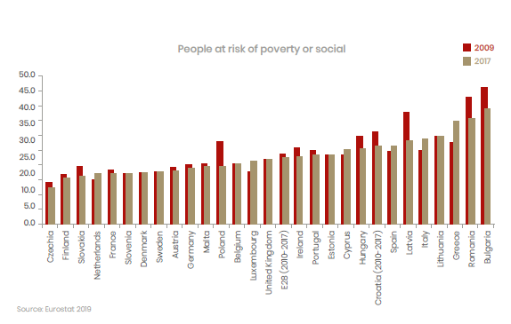
112,978,000 people in poverty or social exclusion (2017)

Slide 5
112,978,000 people in poverty or social exclusion (2017)
Only a million and a half almost ten years – EU targets not reached (20 million)
Increasing employment rates and decreasing unemployment (in most countries)
Labour market conditions improve
Income inequality high
Demographic changes (birth, ageing, migration)

Slide 6
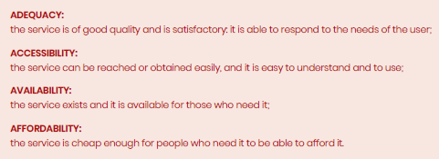
Focus of Report: Access to services

Slide 7
Public Employment Services
Main obstacles:
Administrative
Lack of a personalised and caring approach
Language barriers, lack of recognition of skills (migrants)
Lack of formal requirements, lack of access in rural areas

Slide 8
Housing
Main obstacles:
Costs
Inadequacy of public housing
Lack of availability of social/public housing: move towards private options
Inadequacy of public

Slide 9
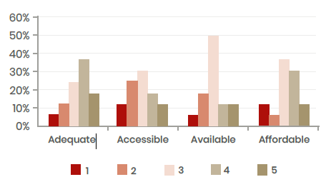
Early childhood education and care
Main obstacles:
Lack of places in kindergartens
Conditions – requirement for work
Affordability
8

Slide 10
Services for people who are homeless
Main obstacles:
Availability
Information
Accessibility
Requirements on users
9

Slide 11
Conclusions
A lot is better…but the situation for people in vulnerable situations, or people experiencing poverty is still immensely challenging in Europe.
Some key opportunities ahead through EU action:
EU support creation of quality jobs (support through investment in social economy entreprises, set minimum rules for wage, income);
Invest in younger (and older) workers
Implementation of work-life-balance directive, invest in health and long-term care
Safeguarding access to social rights: implementation of the Europan Pillar of Social Rights
Earmark sufficient funds in European budget (future ESF+) to allow for inclusion of the most deprived
Participation of People Experiencing Poverty

Slide 12
Thank you for your attention!

